Slide 1
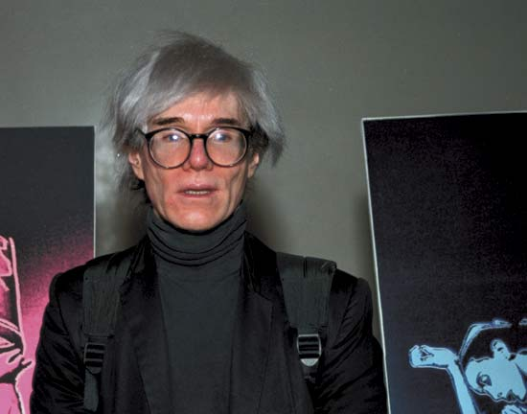
"If you want to know all about Andy Warhol, just look at the surface of my paintings and films and me, and there I am. There's nothing behind it." --Andy Warhol
Andy Warhol 1928- 1987
POP ART

Slide 2

“I do the same thing everyday. I go to work and paint. I try to turn out as many pictures as I can.” – Andy Warhol

Slide 3
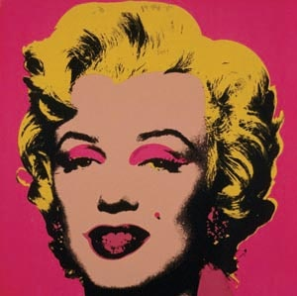
“I paint anybody, anybody that asks me.” – Andy Warhol

Slide 4
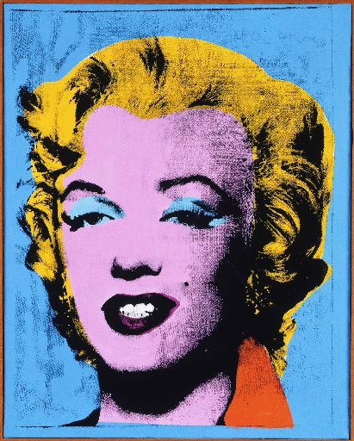

Slide 5
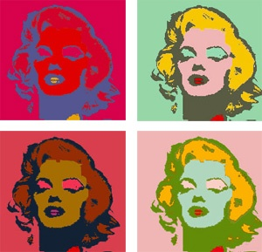

Slide 6
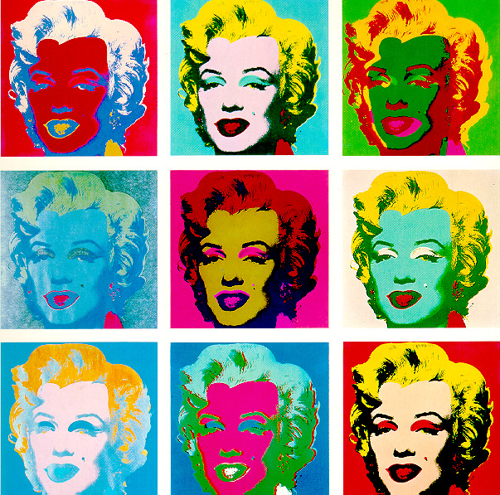

Slide 7
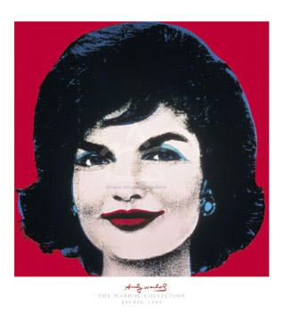

Slide 8


Slide 9

Painting Title: Self Portrait 1967 Andy Warhol

Slide 10
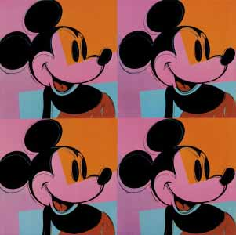

Slide 11
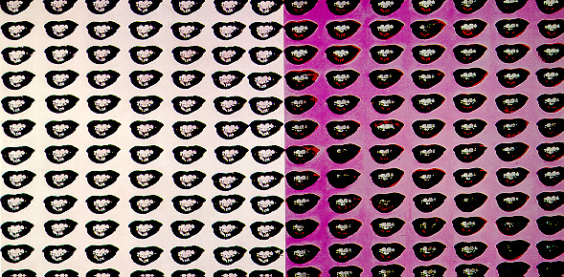

Slide 12


Slide 13


Slide 14
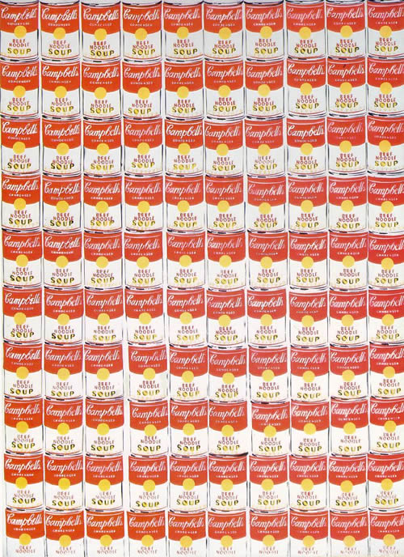

Slide 15
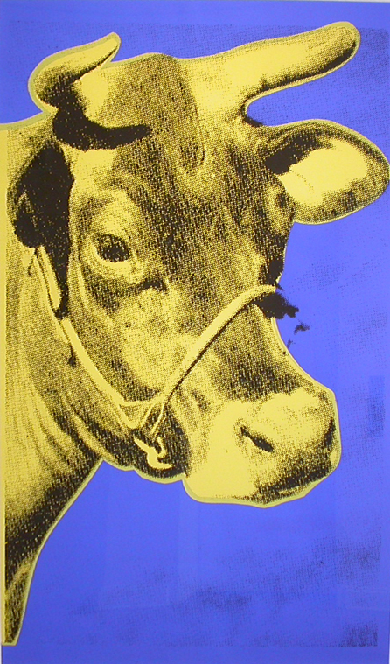

Slide 16
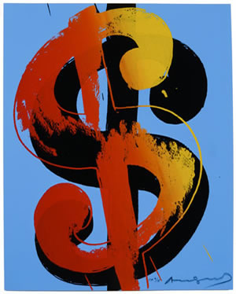

Slide 17
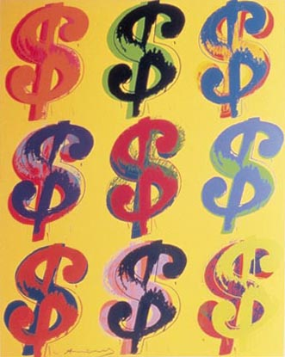

Slide 18
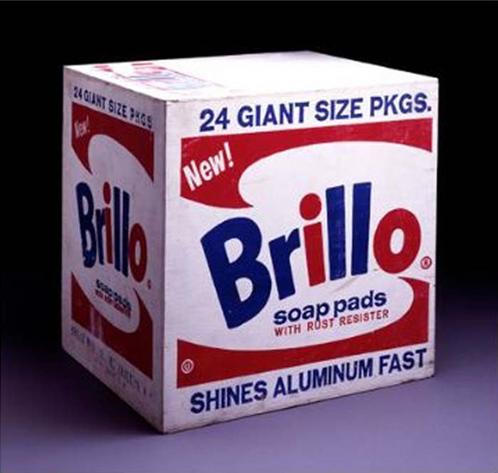

Slide 19
